Slide 1
Resilient and Scalable Architecture for Permissioned Blockchain Fabrics
Suyash Gupta
Ph.D. Exit Seminar
Exploratory Systems Lab
University of California Davis
https://gupta-suyash.github.io/

Slide 2
Bank
Savings
Savings
Bob
Alice

Slide 3
Bank
Lost Job
Blocks her Savings
Misses Loan Payments
House Loan
Buys House
House
Bob
Alice

Slide 4
How could this happen?
Centralization
Monopoly
Lack of Control
No Voice

Slide 6
Solution???

Slide 7
Desired Properties
Decentralization
Democracy
Control of Data
Right to Vote

Slide 8
Decentralization → Data Control
Alice
Bob

Slide 9
Democracy → Vote
Alice
Bob

Slide 10
Commit Protocols
Partitioned (Sharded) Databases
Every node holds its copy of data.
Decision making → Agreement between nodes.
Two-Phase Commit Protocol → Blocking
Three-Phase Commit Protocol → Expensive
Our Solution
First Transmit then Commit
EasyCommit Protocol → Two phases & non-blocking [EDBT’18]
Wide Area Networks → GeoScale EasyCommit Protocol [DAPD’20]

Slide 11
Are we done?
Commit protocols support only node failures.
Cannot handle message loss, delays or network failures.

Slide 12
Everything is fine until there are Adversaries!
Alice
Bob

Slide 13
Decentralization → Replicated Database
Alice
Bob

Slide 14
Voting Rules → Consensus
Every replica should vote once!
Count each vote only once!
Winner → who gets majority of votes.
Ensure only one winner!

Slide 15
Byzantine-Fault Tolerant Consensus
Secure
Authenticated

Slide 16
Minimal Expectations!
Be Safe → All replicas should have same state.
X = 1
X = 1
X = 1

Slide 17
Minimal Expectations!
Stay Live → System should continue processing transactions from good clients.

Slide 18
Immutable Ledger → Blockchain
New
Block
Previous
Hash
Genesis
Previous
Hash
Previous
Hash
Data
Data
Data
Client Transactions
Linked List of Blocks
Hash of Previous Block

Slide 19
Blockchain Applications??

Slide 20
There are many more…
Project Tracking
Energy Trading
and Management
Waste
Management
Healthcare

Slide 21
Why only Cryptocurrencies?
Low Throughput → < 10 txns/s.
Extreme Energy consumption (Proof-of-Work).
Reward-based model!
Identities unknown.
Multiple chains -- Forks!

Slide 22
Research Focus → Make BFT Consensus Efficient
No Compromise on Security

Slide 23
First practical BFT implementation.
Practical Byzantine Fault Tolerance (PBFT)
Client
T
Primary
Replica 1
Replica 2
Byzantine
Client
Request
Pre-Prepare
O(n)
Prepare
O(n²)
Commit
O(n²)
Reply
Execute
Two Phases of O(n²)!!!
Consensus among n replicas & at most f byzantine → n >= 3f+1
n = 4 replicas and f <= 1

Slide 24
Several Exciting Solutions
Twin-path protocols →
Zyzzva [SOSP’07], SBFT [DSN’19]
Fast-path and Slow-path.
Fall in throughput on failures.

Slide 25
Speculative Execution
Proof-of-Execution (PoE)*
Three-phase Linear protocol
Out-of-Order Message Processing
No dependence on clients or trusted component.
*In proceedings of EDBT 2021.

Slide 26
Proof-of-Execution (PoE)
Client
T
Primary
Replica 1
Replica 2
Byzantine
Replica
Client
Request
Pre-Prepare
Prepare
Certify
Reply
Execute
n = 4 replicas and f <= 1

Slide 27
Magical Ingredient → Client Commit implies Finality
If client receives n-f responses → Transaction will persist in time.
Replicas may be required to rollback.

Slide 28
What Limits Current Systems? Primary-Backup Paradigm
OK
OK
Replace Primary
System Halts
Order Txn
Primary
OK
Fall in throughput!
Primary

Slide 29
Our Proposal
Democracy → Give all the replicas the power to be the primary.
Parallelism → Run multiple parallel instances of a BFT protocol.
Decentralization → Always there will be a set of ordered client requests.
Resilient Concurrent Consensus

Slide 30
RCC Paradigm*
Parallelism
Ordering
Execution
BFT protocol
Run z parallel BFT
instances.
Create a global order
of all the requests.
Execute the requests
in a global order.
Number of
Instances (z)
*In proceedings of ICDE 2021 and DISC 2019.

Slide 31
Client
T
1
Primary
Replica
2
1
Replica
2
Client
T
Primary
Replica
1
2
Byzantine
Replica
1
2
Request
Pre-Prepare
Prepare
Commit
Reply
RCC using PBFT with z = 2 parallel instances.

Slide 32
Challenges?
How to securely order the requests?
Does failure of one instance causes other instances to stop?
Can there be continuous ordering of requests?
How to fend against coordinated attacks?

Slide 33
Ordering Attack
transfer(A,B,m) → if
bal(A) > m
then
bal(A) = bal(A) – m;
bal(B) = bal(B) + m;
Benefit to Bob!
T1: transfer(Alice, Bob, 2)
T2: transfer(Bob, Eve, 1)
Alice
Bob
Eve
3
1
5
0
5
2
0
3
0
2
0
1
Case 1: T1 then T2
Case 2: T2 then T1

Slide 34
Magical Ingredient → Secure Ordering
In round r, each replica does the following:
Collects requests from the z instances.
Creates a sequence S of these requests.
Hashes this sequence.
Calls the function fS on the hash.

Slide 35
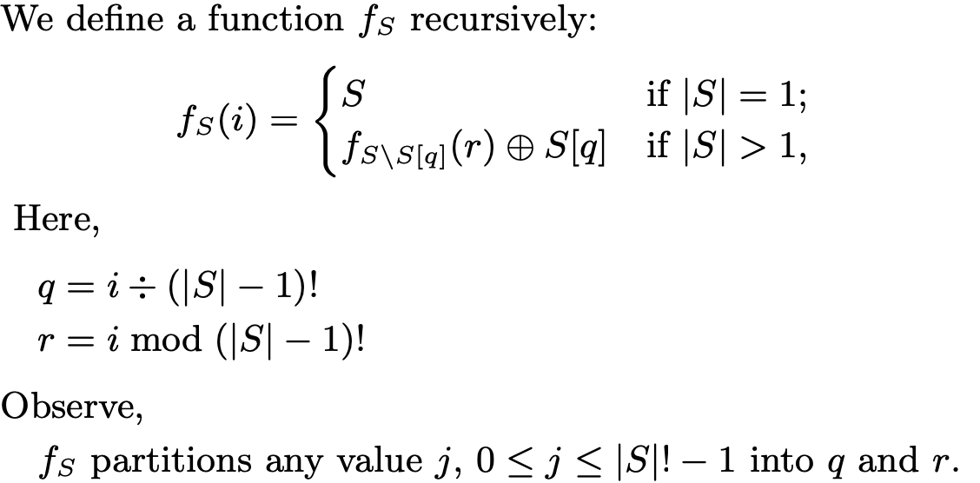
Magical Ingredient → Secure Ordering

Slide 36
Malicious Primaries Collusion
Good Replicas
|A| = f
Good Replica
|C| = 1
Good Replicas
|B| = f
T₁
T₁
T₂
T₂
T₁
T₂
P₁
|M| = f
Liveness in Danger!
P₂
Other f-2
Malicious Replicas

Slide 37
Magical Ingredient → Good Instances are always Live
Failed instances are stopped and not replaced through independent consensus.
Failed instances can be restarted in future.
Failed instances are stopped and not replaced through independent consensus.
Failed instances can be restarted in future.
Collusion attacks detected when f+1 blame multiple primaries.
Lightweight checkpoints ensure progress.

Slide 38
ResilientDB: High Throughput Yielding, Scalable Permissioned Blockchain Fabric*
Visit at: https://resilientdb.com/
*In proceedings of ICDCS 2020 and VLDB 2020.

Slide 39
Why Should You Chose ResilientDB?
Bitcoin and Ethereum offer low throughputs of 10 txns/s.
Existing Permissioned Blockchain Databases still have low throughputs (20K txns/s).
Prior works blame BFT consensus as expensive.
System Design is mostly overlooked.
ResilientDB adopts well-researched database and system practices.

Slide 40
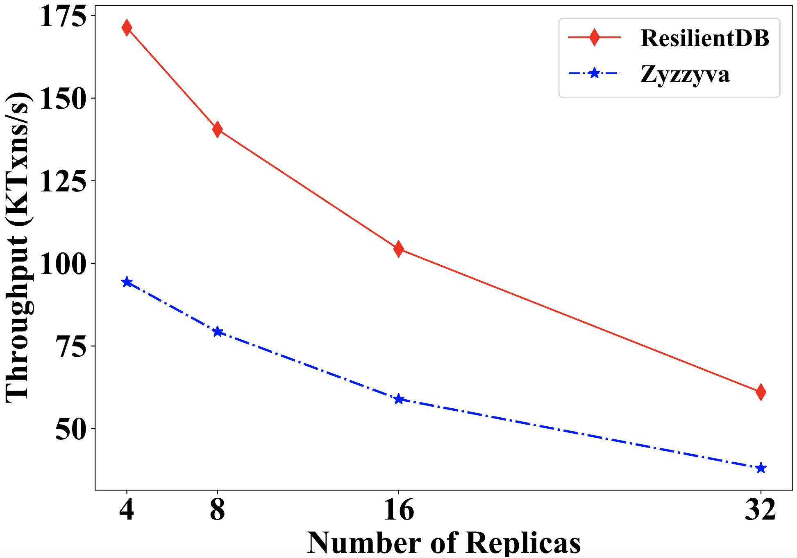
Can a well-crafted system based on a classical BFT protocol outperform a modern protocol?

Slide 41
ResilientDB Architecture
SECURE
LAYER
EXECUTION LAYER
THREADS
SIGNING
TOOLKIT
QUEUES
NET WORK
HASHING
TOOLKIT
BFT CONSENSUS
STORAGE LAYER
METADATA
BLOCKCHAIN

Slide 42
Implementation on ResilientDB
Network
Network
REPLICA
Client
Requests
Batching
Prepare & Commit
messages
Input
Output
Message from
Clients and Replicas
Message to
Replicas or Clients
Worker
Execute
Certificates
from other clusters
Certify
ResilientDB associates a multi-threaded deep-pipelined architecture with each replica.

Slide 43
Evaluating RCC on ResilientDB

Slide 44
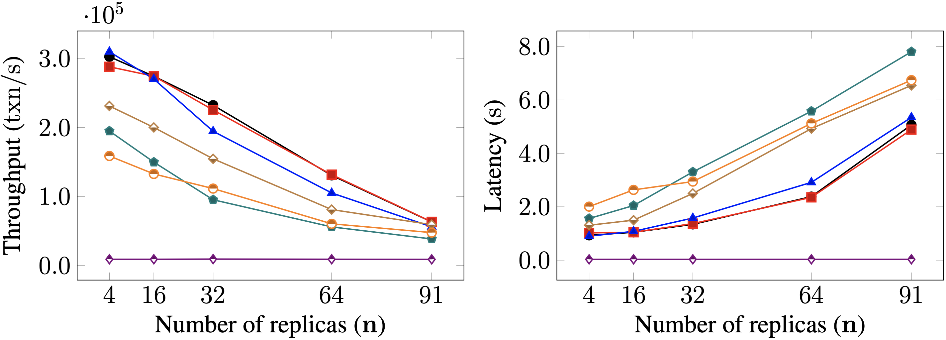
Scalability

Slide 45
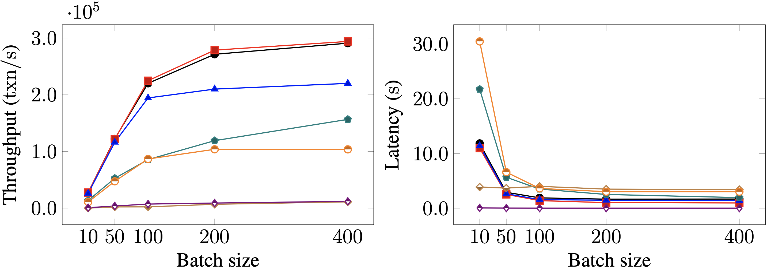
Batching

Slide 46
The Big Picture…
Blockchain as a Service

Slide 47
Future Directions: Trusted Computing
Existing BFT protocols using Trusted Components
Prevent Equivocation
Require 2f+1 replicas
Our Observations
Limited Liveness, Recovery, and Lack Concurrency.
Our Proposals
Safe, Live and Concurrent Protocols.

Slide 48
Future Directions: Serverless-Edge Computing
Emerging Edge computing applications → Internet of Things
Edge Devices → Limited compute power and memory
Serverless Computing → Scalable and administration-free
Solution? → Serverless + Edge
Untrusted → Byzantine attacks

Slide 49
Future Directions: Geo-Scale Consensus*
Local Replication
Inter-cluster Sharing
Ordering and Execution
Each cluster runs BFT to select, locally replicate, and certify a client request.
Primary at each cluster shares the certified client request with other clusters.
Order the certified requests, execute them, and inform local clients.
Topology-aware meta-protocol.
Parallel consensus at each cluster.
Low inter-cluster communication overheads.
*In proceedings of VLDB 2020.

Slide 50
Conclusions
Need for decentralized and democratic agreement.
Existing commit protocols expensive and blocking.
Use EasyCommit and GeoScale EasyCommit protocols.
Commit protocols cannot handle byzantine attacks.
Existing byzantine fault-tolerant protocols limited.
PoE → Linear, Uses speculative execution and supports out-of-order processing.
RCC → Parallel, Democratic and can employ any efficient protocol at its core.
ResilientDB → Fulfills the dream of high-throughput blockchain fabric.

Slide 51
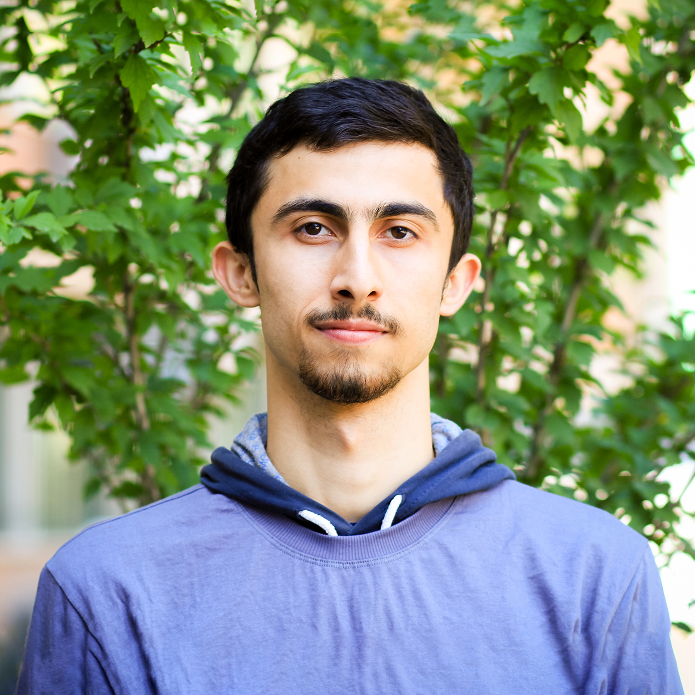
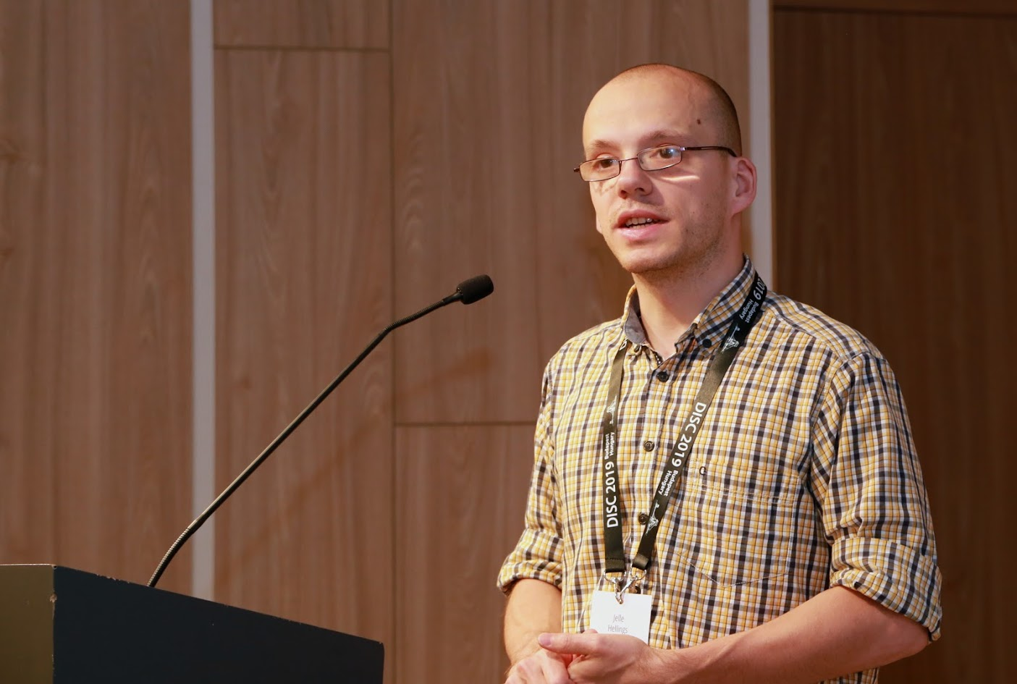
Expolab Team (Heartful Thanks)
Resilient Co-authors
Efficient Advisor
Sajjad Rahnama
Jelle Hellings
Non-faulty Co-authors
Mohammad Sadoghi
Thamir Qadah
Shubham Pandey
Rohan Sogani

Slide 52
Special Acknowledgments
Dahlia Malkhi (Internship Advisor, Novi / Diem)
Cindy Rubio González and Aditya Thakur (Thesis Committee, UC Davis)
Amar El Abbadi (UC Santa Barbara) and Jason Lowe-Power (UC Davis) – Qual Committee
Faisal Nawab (UC Irvine) and Natacha Crooks (UC Berkeley) – Collaborators
Dipak Ghosal (UC Davis) – CS Graduate Chair
Jessica Stoller, Alyssa Bates, and Noreen Johnson – UC Davis, Graduate Staff
Santosh Kumar (Dad), Manju Gupta (Mom) and Shrey Gupta (Bro, Emory University)
Rashmi Kumar – Stanford University

Slide 53
Publications
Books
S. Gupta, J. Hellings and M. Sadoghi, Fault-tolerant Distributed Transactions on Blockchain, Morgan & Claypool Synthesis Lectures on Data Management, 2021.
Conferences
S. Gupta, J. Hellings, S. Rahnama and M. Sadoghi, Proof of Execution: Reaching Consensus through Fault-Tolerant Speculation, To appear in 24th International Conference Extending Database Technology (EDBT). 2021.
S. Gupta, J. Hellings and M. Sadoghi, RCC: Resilient Concurrent Consensus for High- Throughput Secure Transaction Processing, To appear in 37th IEEE International Conference on Data Engineering (ICDE). 2021.
S. Gupta, S. Rahnama and M. Sadoghi, Permissioned Blockchain Through the Looking Glass: Architectural and Implementation Lessons Learned, In 40th IEEE International Conference on Distributed Computing Systems (ICDCS). 2020.
S. Gupta, S. Rahnama, J. Hellings and M. Sadoghi, ResilientDB: Global Scale Resilient Blockchain Fabric, In 46th International Conference on Very Large Databases (VLDB). 2020 — Artifact Evaluated.
T. Qadah, S. Gupta and M. Sadoghi, Q-Store: Distributed, Multi-partition Transactions via Queue-oriented Execution and Communication. In 23rd International Conference of Extending Database Technology (EDBT), 2020.
S. Gupta, J. Hellings and M. Sadoghi, Brief Announcement: Revisiting Consensus Protocols through Wait-free Parallelization, In 33rd International Symposium on Distributed Computing (DISC). 2019.
S. Gupta and M. Sadoghi, EasyCommit: A Non-blocking Two-phase Commit Protocol, In 21st International Conference of Extending Database Technology (EDBT), 2018.
S. Gupta, R. Shrivastava, and V. K. Nandivada, Optimizing Recursive Task Parallel Programs, In 31st International Conference on Supercomputing (ICS), 2017.

Slide 54
Publications
Journals
S. Gupta and M. Sadoghi, Efficient and non-blocking agreement protocols, Distributed and Parallel Database (DAPD), 2019.
S. Gupta and V. K. Nandivada, IMSuite: A Benchmark Suite for Simulating Distributed Algorithms, Journal of Parallel and Distributed Computing (JPDC), Elsevier, 2015.
Selected Articles
S. Gupta, Resilient and Scalable Architecture for Permissioned Blockchain Fabrics, PhD Workshop, In 46th International Conference on Very Large Databases (VLDB), 2020.
S. Gupta, J. Hellings, T. Qadah, S. Rahnama and M. Sadoghi, Efficient Transaction Processing in Byzantine Fault Tolerant Environments, In International Workshop on High Performance Transaction Systems (HPTS), 2019 – A Biennial Workshop.
S. Gupta and M. Sadoghi, Blockchain Transaction Processing, In Encyclopedia of Big Data Technologies. Springer, Cham, 2018.
Tutorials
S. Gupta, J. Hellings, S. Rahnama and M. Sadoghi, Building High Throughput Permissioned Blockchain Fabrics: Challenges and Opportunities, In 46th International Conference on Very Large Databases (VLDB), 2020.
S. Gupta, J. Hellings, S. Rahnama and M. Sadoghi, Blockchain consensus unraveled: Virtues and Limitations, In 14th ACM International Conference on Distributed and Event- Based Systems (DEBS), 2020.
S. Gupta, J. Hellings, S. Rahnama and M. Sadoghi, An In-Depth Look of BFT Consensus in Blockchain: Challenges and Opportunities, Middleware Tutorials, 2019.
Demonstrations
S. Rahnama, S. Gupta, T. Qadah, J. Hellings and M. Sadoghi, Scalable, Resilient and Configurable Permissioned Blockchain Fabric, In 46th International Conference on Very Large Databases (VLDB), 2020.

Slide 55
What if replicas are globally scattered?

Slide 56
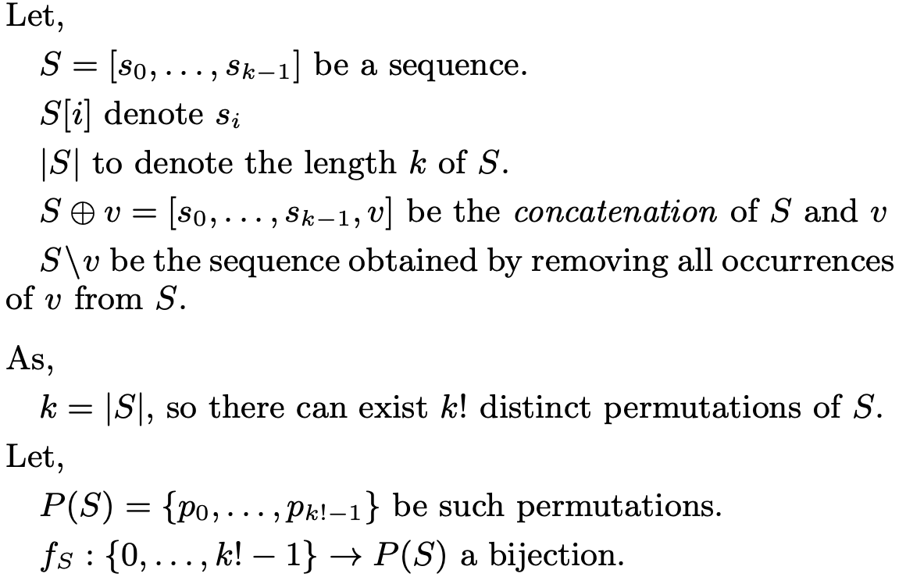
Secure Ordering Solution

Slide 57
Dissecting Existing Permissioned Blockchains
Single-threaded Monolithic Design
Successive Phases of Consensus
Integrated Ordering and Execution
Strict Ordering
Off-Chain Memory Management
Expensive Cryptographic Practices

Slide 58
Future Directions… Blockchain Storage
Sharded or Partitioned Databases
Client Transaction Verification
Bloom Filters, Stacked Filters
Client Query Optimization and Data-Management
Need for efficient indexing.
Patricia Merkle-Trees → Distributed and/or Partitioned.
Authenticated LSMs.

Slide 59
Thank You

