Slide 1
MileStone #1
By: Kiwi Calvin Bear Squid

Slide 2
Our Structure
Stores our data in a columnar form, with base pages, tail pages, and meta datas.
Data
Models
Manages the data structure, maintaining page ranges, directory, and maps RIDS to the necessary locations.
Bufferpool Management
Provides the table functions, improving the ways to access data.
Queries

Slide 3
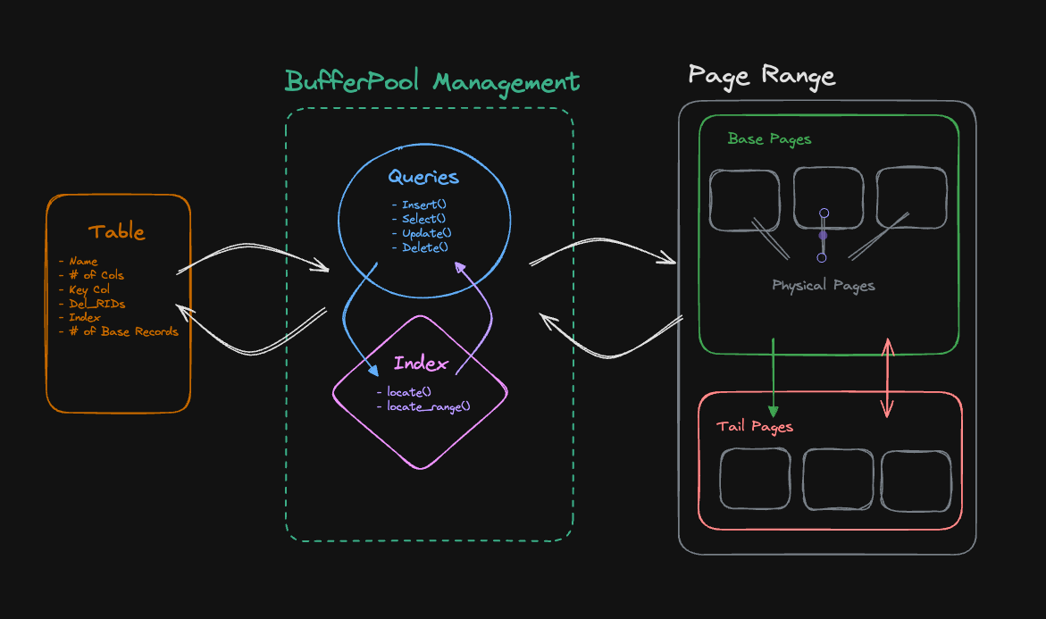

Slide 4
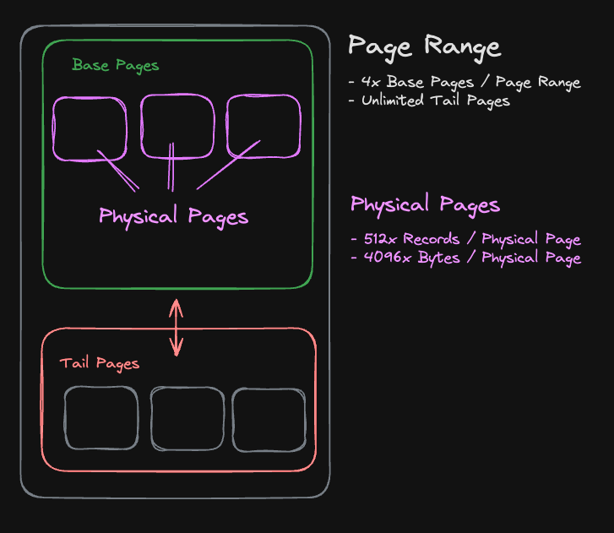

Slide 5
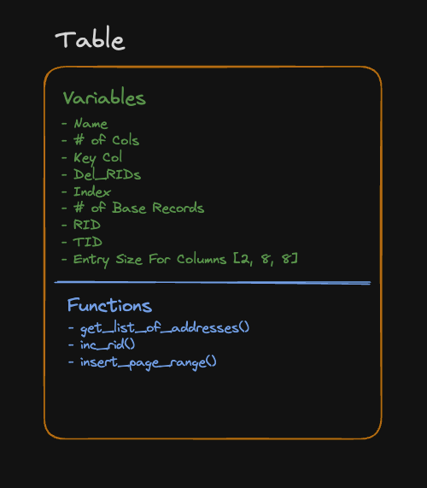

Slide 6
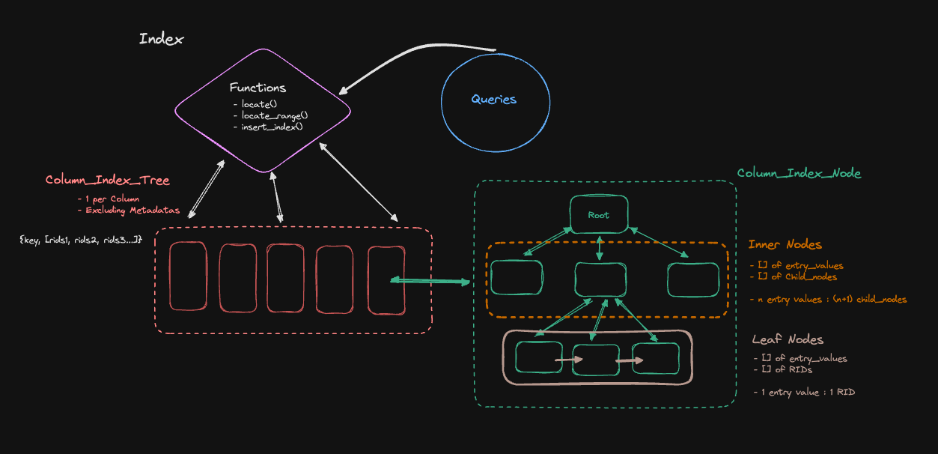
Index

Slide 7
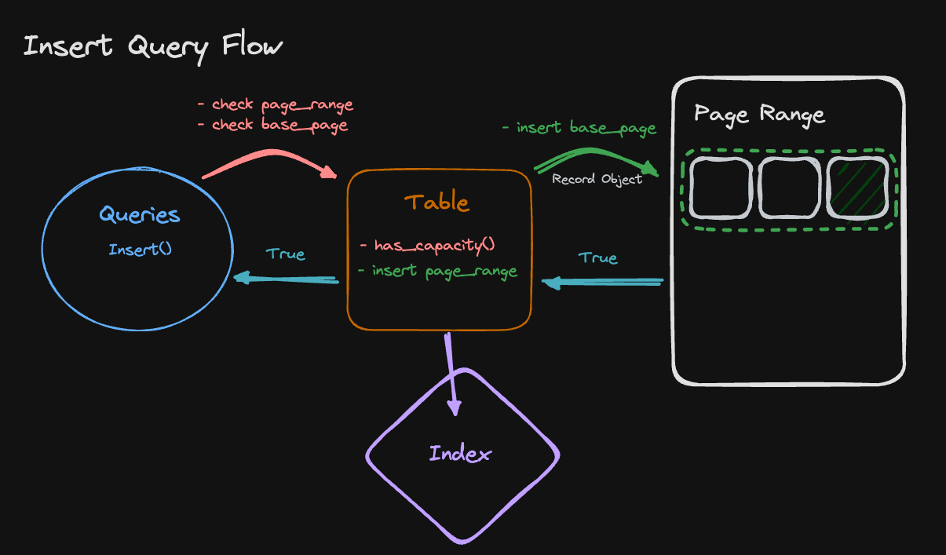
Queries: Insert

Slide 8
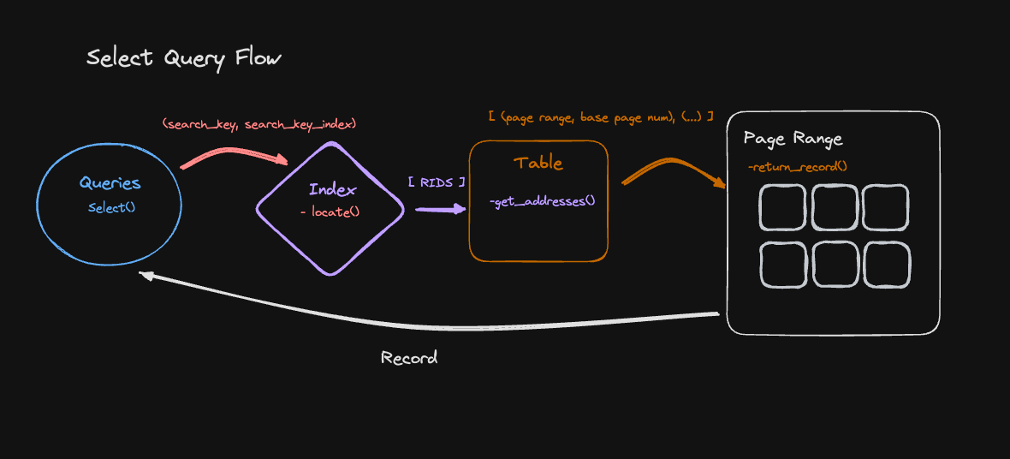

Slide 11
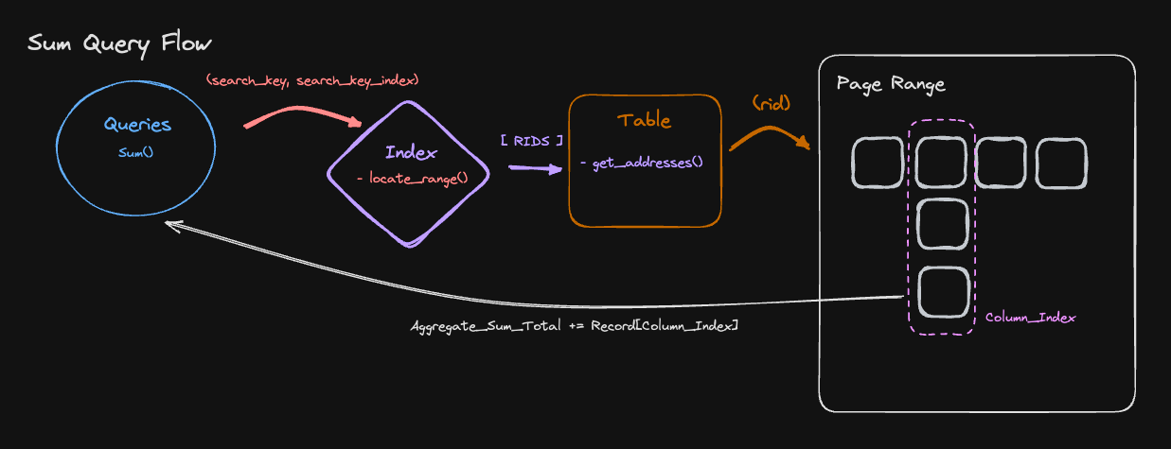

Slide 12
Runtimes

Slide 13
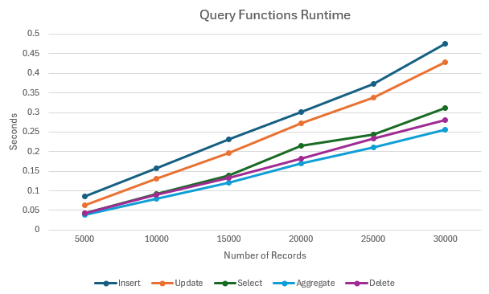
Query Runtimes for number of Records

Slide 14
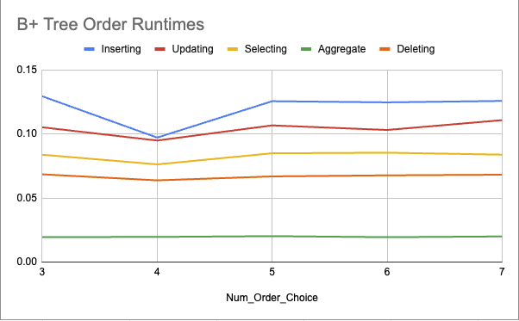
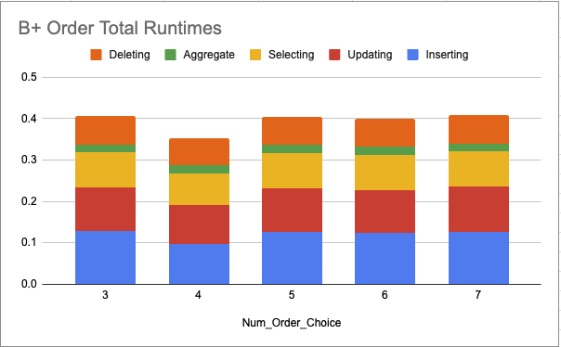
Num Order Choice
Comparing runtimes for different numbers of order choices

Slide 15
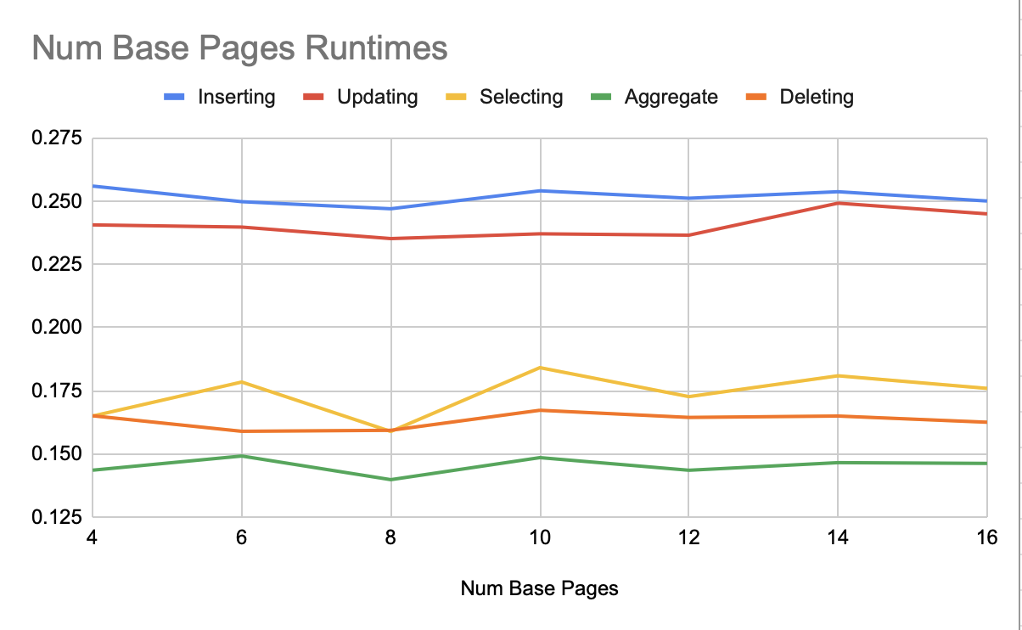
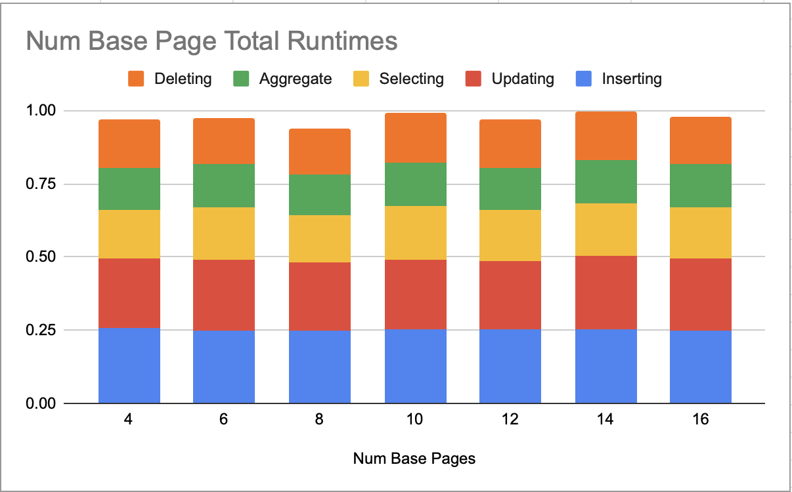
Num Base Pages
Comparing runtimes for different numbers of base pages

